Slide 1
The number of crossings of curves on surfaces
Moira Chas from Stony Brook University
King Abdul- Aziz University
Spring 2012
1

Slide 2
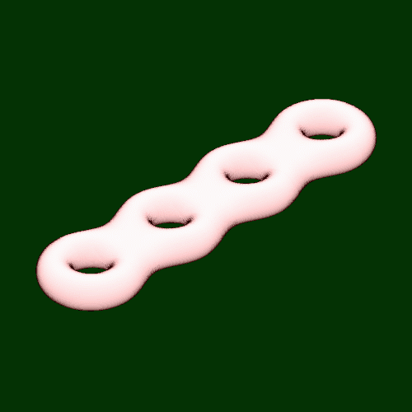
Example of surface without boundary

Slide 3
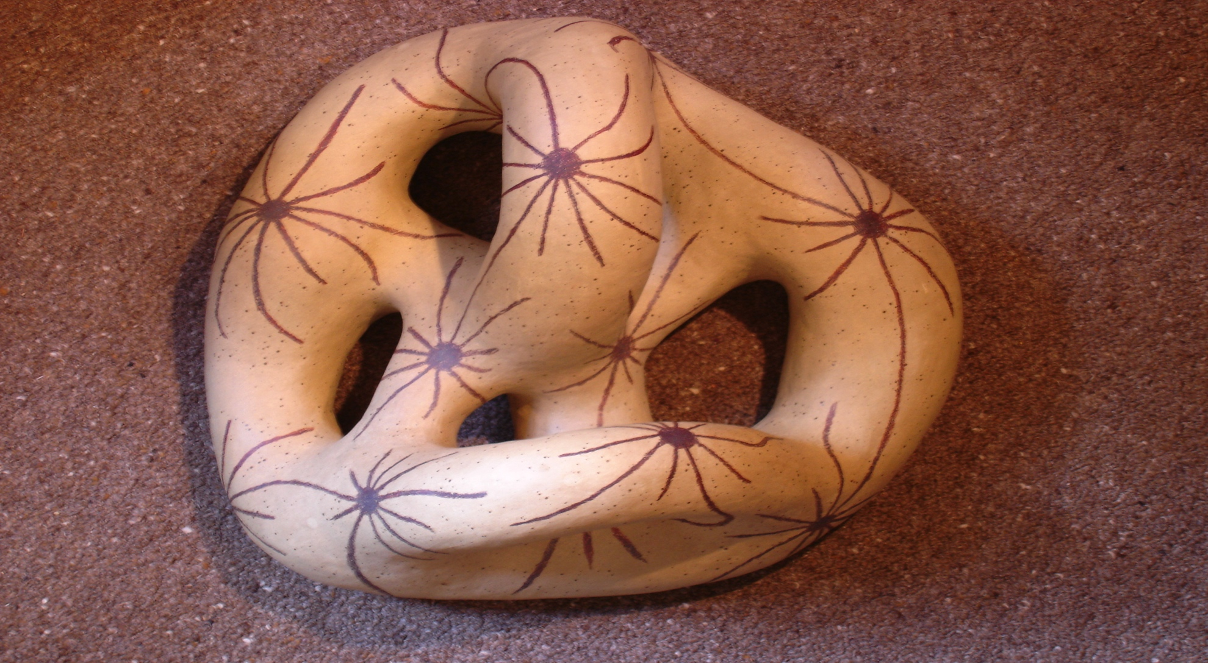
Example of surface without boundary

Slide 4
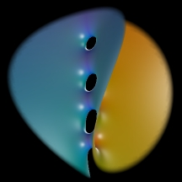
Example of surface with boundary

Slide 5
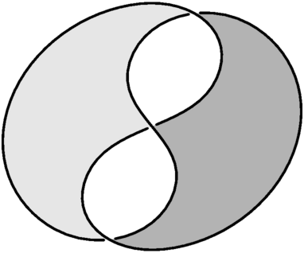
Example of surface with boundary

Slide 6
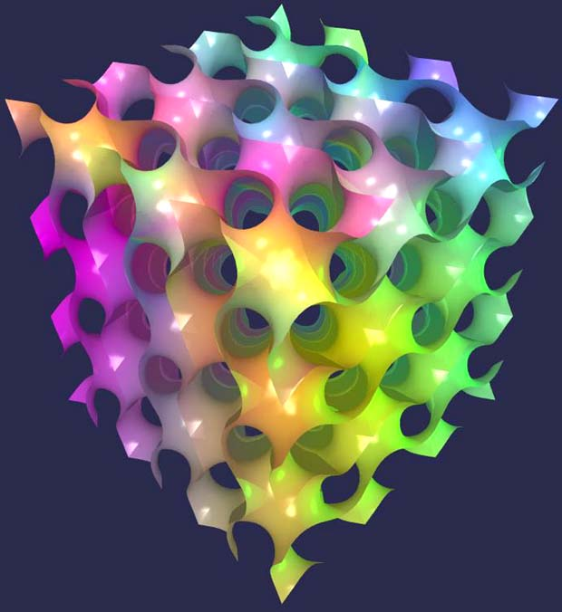
Example of surface with boundary

Slide 7

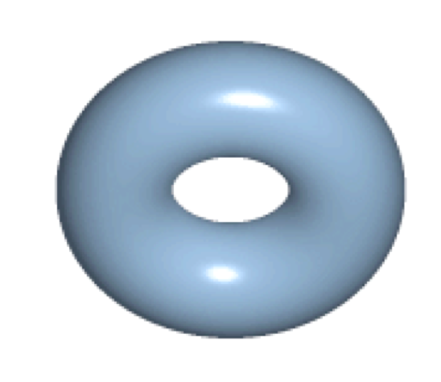
Topology joke: A topologist can't distinguish a coffee mug from a doughnut
Animation on this page courtesy of wikipedia

Slide 8
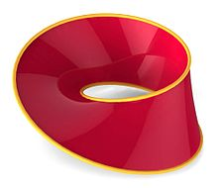
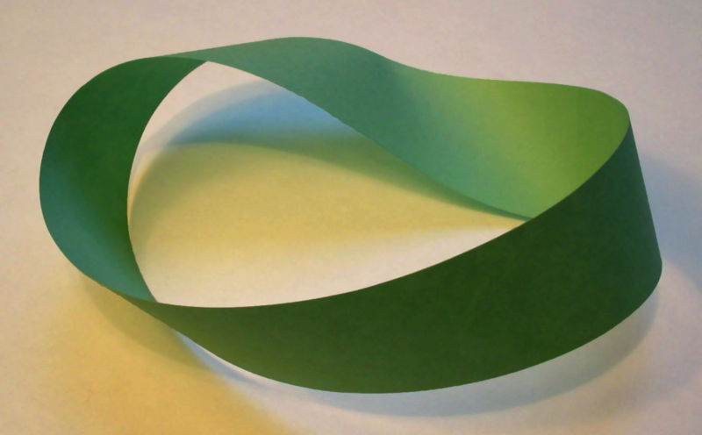
Orientation of a surface
A surface is orientable if it is “two sided” or equivalently, if it does not contain a Möbius strip.
From now on, we will consider only orientable surfaces

Slide 9
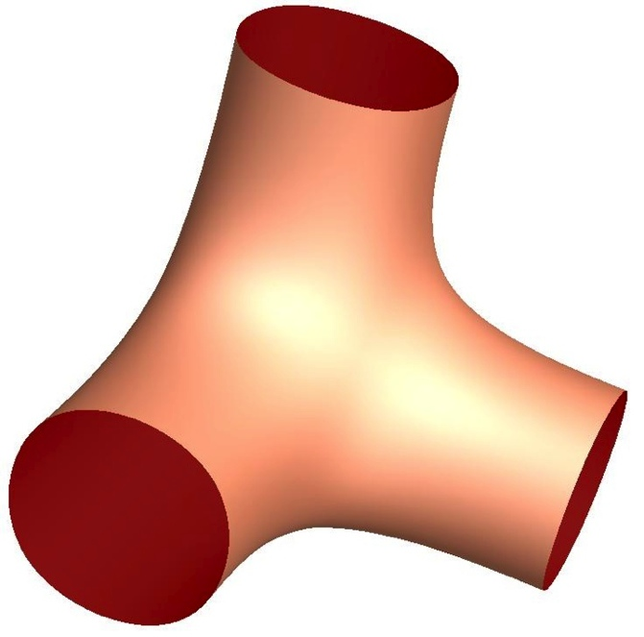
We will study surfaces fro the topological point of view.
These two surfaces are equivalent from the topological point of view.
Notes:
Moebius strip

Slide 10
In order to study surfaces, we will “cut” them. A cut goes from a boundary component to another, and it is labeled as in the figure.
Notes:
Moebius strip

Slide 11
We “open up” the cuts
Notes:
Moebius strip

Slide 12
After we open up the cuts, we deform the surface to a polygonal shape. (This deformation gives an equivalent shape from the topological point of view)
Then we read the ring of letters. This ring contains all the topological information of the surface.
S_{w}
W
Encoding
the
surface
W -> S_{w}
Notes:
Moebius strip

Slide 13
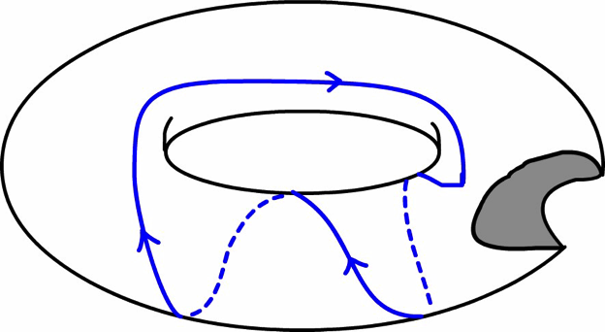
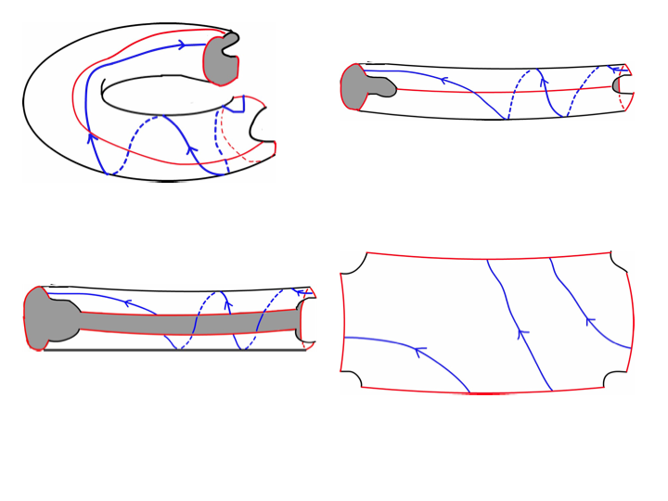
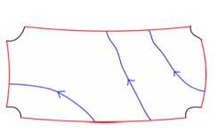
Another example of cutting and opening up a surface.
Note that we obtain a different ring of letters.
S_{w}
Encoding
the
surface
W

Slide 14

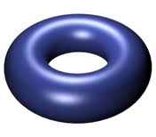
W
S_{w}

Slide 15
A surface alphabet A is a finite alphabet such that for each letter x then x is in A. ( x = x)
A surface word is a ring of symbols in a surface alphabet A containing each letter of A exactly once.
A surface word W determines a surface with boundary.
Every surface with boundary is determined by some surface word.
S_{w}
Surface
EXAMPLE:
A=
{ , , , }
W=

Slide 16

Conventions:
Most words are cyclic

Slide 17
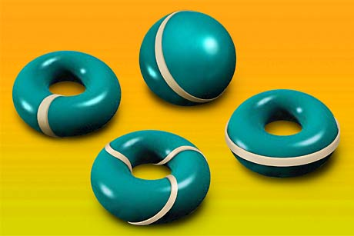

A (closed, oriented) curve on a surface is a continuous map from the oriented circle to the surface

Slide 18
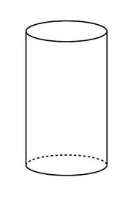
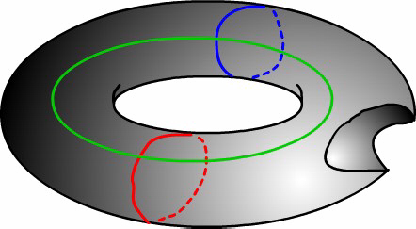
Two curves α and β on a surface S are homotopic if α can be deformed continuously into β on S as maps from the circle into the surface.
Homotopy
Two curves α and β on a surface S are homotopic if there exist a continuous map
F: S¹ x [0,1] -> S, such that
F(t, 0)= α(t)
F(t, 1)= β (t)
for all t in S^{1.}
Note: the curve never leaves the surface when being deformed.
α
F(t,1)
F(t,s)
β
F(t,0)

Slide 19
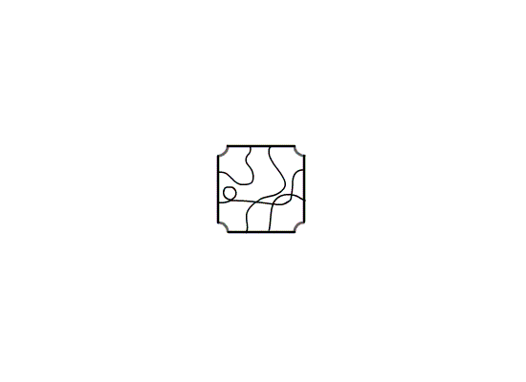
Homotopy
movie
Two curves α and β on a surface S are homotopic if there exist a continuous map
F: S¹ x [0,1] -> S, such that
F(t, 0)= α(t)
F(t, 1)= β (t)
for all t in S^{1.}

Slide 20
Another example of two curves closed α and β on a surface S which are homotopic

Slide 21
A simple curve is a curve without crossings.

Slide 22
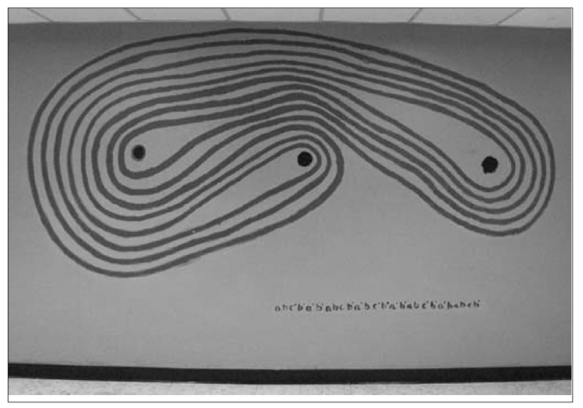
But not all simple curves are so “simple”

Slide 23
From now on, we fix a surface word (and therefore a surface)
We encode a free homotopy class.
a
b
a

Slide 24
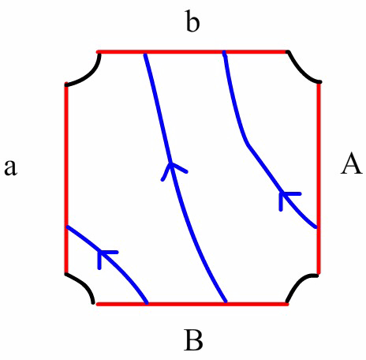
Encoding a free homotopy class
bba

Slide 25
ā
a
b

Slide 26
b
ā
a
b

Slide 27
A reduced cyclic word in a surface alphabet A is a ring of symbols of A such that for each letter u in A, u and ū do not appear consecutively.
(Recall) A surface word is a ring of symbols (like aAbB) which determines a surface.
27

Slide 28
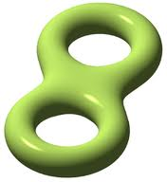
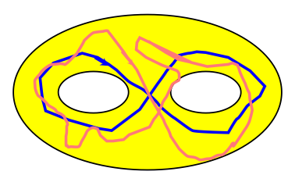
W surface word in surface alphabet A
  Example A={a,b,A,B}, W=aAbB.
S_{W} an orientable surface with boundary
  Examples.
    If W=aAbB then S_{W}=
    If W=abABthen S_{W}=
    If W=abABcdCD=
We consider free homotopy classes of closed directed curves

Slide 29
free homotopy classes of curves on S_{w}
On the pair of pants aAbB (or any surface with boundary S_{w})
one to one correspondence
reduced cyclic words in A

Slide 30

The minimal self-intersection number of the free homotopy class w, SI(w) is the minimum number of crossings of a curve in w
minimal self intersection number = ?

Slide 31
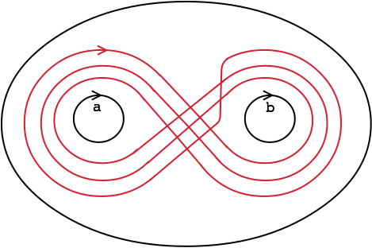
These two curves are homotopic. What is the minimal self-intersection number of their class?

Slide 32
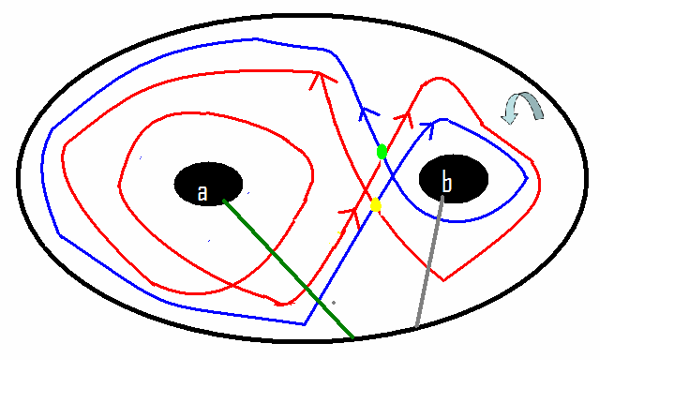
The (cyclic) word aab “talks” about its self-intersection number

Slide 33
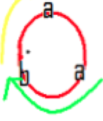
The (cyclic) word aab “talks” about its self-intersection numbers
(ba, ab)

Slide 34
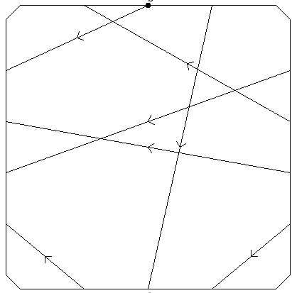
In the torus (Surface word abAB) w=aaabaBB
b
Representative with
minimal self-intersection
(with Chris Arettines
algorithm)
a
A
B
The algorithm to find a representative with minimal self-intersection can be found at
www.math.sunysb.edu/~moira/applets/chrisAplet.html

Slide 35
In the punctured torus (Surface word abAB) w=aaabaBB
b
Linked pairs
aaabaBB, aaabaBB -> aa, BB
aaabaBB ,aaabaBB -> aa,BB
aaabaBB, abaBBaa ->aab, Baa
BaaabaB,aaabaBB ->Baaa, aaab
aaabaBB , aabaBBa -> aba, Bba
aaabaBB,aaabaBB -> aBB, aba
6
5
3
1
a
A
4
2
B

Slide 36
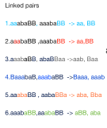
Theorem (Reinhart ‘62, Birman-Series ‘83, Cohen-Lusting ‘86, C. ‘04)
Let S be an orientable surface with boundary.
Let V be a surface word yielding S~S_{V}. (Example V=abAB)
Consider a free homotopy class of curves on S, labeled by a cyclic reduced word w (Example w=aaabaBB)
Let α be a representative of w self-intersecting transversally in the minimal number of points.
b
a
A
one-to-one
correspondence
B
linked pairs of w
Self-intersection points of α.
Linked pairs are
determined by V

Slide 37
length SI | 0 | 1 | 2 | ...
1
2 |  | # of cyclic reduced words with self-intersection=1, two lettters
3
4

Slide 38
On aAbB length / SI | 0 | 1 | 2 | 3
1 | a, b, A, B 4 | 0 | 0 | 0
2 | aB, Ab 2 | aa, bb, AA, BB,ab, AB, 6 | 0 | 0
3 | 0 | aab, abb, AAB, ABB 4 | aaa, aaB, aBB, AAA, Aab, Abb, bbb, BBB 8 | 0
4

Slide 39
 | 0 | 1 | 2 | 3 | 4 | 5 | 6 | 7 | 8
1 | 4 | 0 | 0 | 0 | 0 | 0 | 0 | 0 | 0
2 | 2 | 6 | 0 | 0 | 0 | 0 | 0 | 0 | 0
3 | 0 | 4 | 8 | 0 | 0 | 0 | 0 | 0 | 0
4
5
6
7

Slide 40
 | 0 | 1 | 2 | 3 | 4 | 5 | 6 | 7 | 8
1 | 4 | 0 | 0 | 0 | 0 | 0 | 0 | 0 | 0
2 | 2 | 6 | 0 | 0 | 0 | 0 | 0 | 0 | 0
3 | 0 | 4 | 8 | 0 | 0 | 0 | 0 | 0 | 0
4 | 0 | 2 | 10 | 12 | 0 | 2 | 0 | 0 | 0
5 | 0 | 0 | 4 | 20 | 20 | 4 | 4 | 0 | 0
6 | 0 | 0 | 2 | 12 | 34 | 36 | 26 | 16 | 0
7 | 0 | 0 | 0 | 4 | 24 | 56 | 72 | 76 | 44

Slide 41
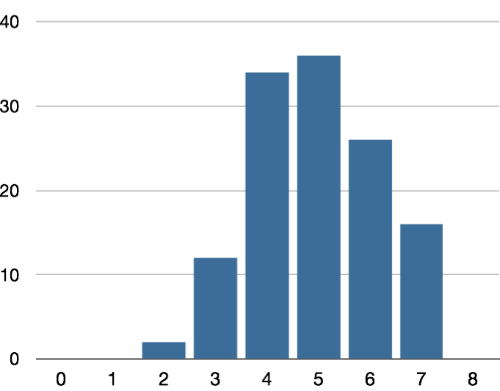
126 cyclic reduced words of 6 letters
 | 0 | 1 | 2 | 3 | 4 | 5 | 6 | 7 | 8
6 | 0 | 0 | 2 | 12 | 34 | 36 | 26 | 16 | 0

Slide 42
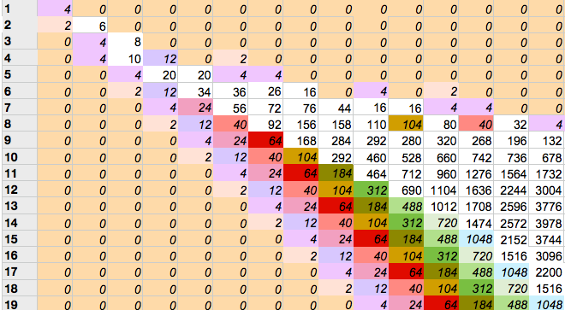
Self-intersection/length for the pair of pants W=aAbB

Slide 43
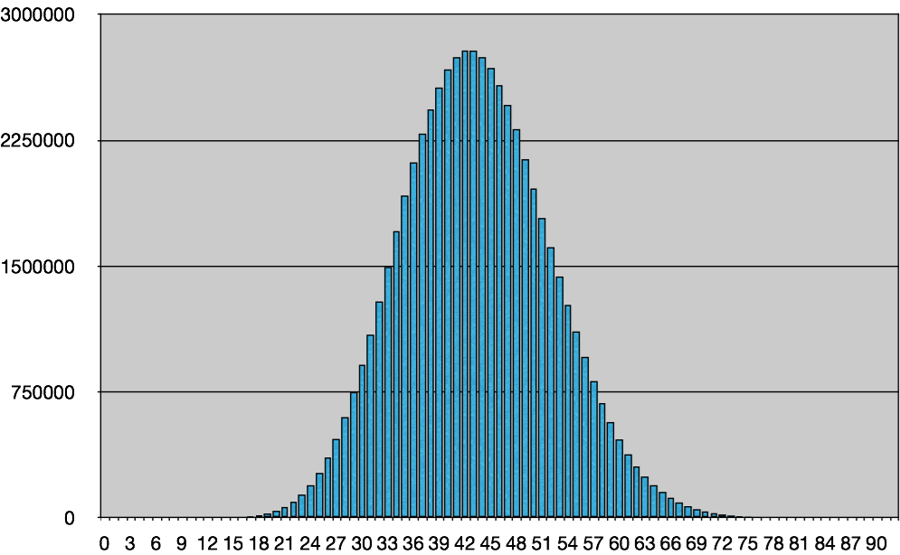
Approximately, 61,000,000 cyclic reduced words of length 19
organized by number of crossings.
19²/9~40
19²/4~90

Slide 44
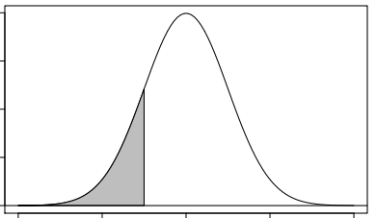
Fix a set U, write it as an increasing union of finite sets C_{L}.
Consider a function f from U to R (the real numbers)
For each L, and each positive number r, study
M(L,u) =
#{u in C_{L} such that f(u)<r} /#C_{L.}
U= all free homotopy classes of closed curves on S. C_{L} = all elements in U that can be described with a word of L letters.
For each u in U, set f(u)=self-intersection number of u.
Theorem: When L is large,
M(L,u)=shaded
area
u
Fix S an orientable surface with boundary S,
Choose a surface word W such that S~S_{W},

Slide 45
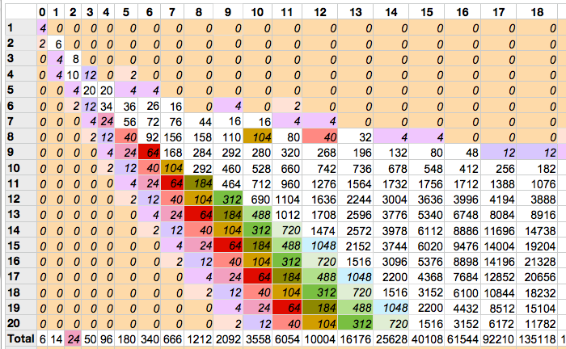
Self-Intersection-Combinatorial length in pants, aAbB
Open Problems:
Describe and explain patterns in columns.
More generally, describe the function F(L,i)=number of words in cell (L,i).

Slide 46
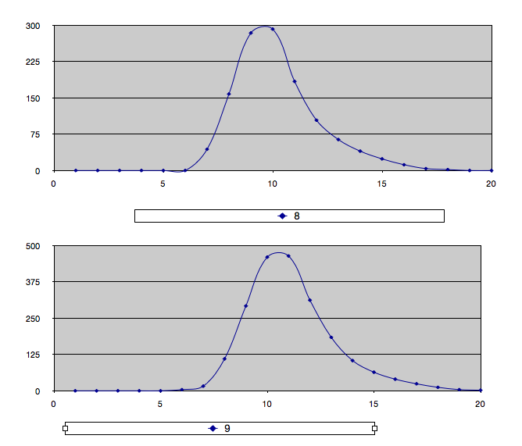
Self-Intersection-Combinatorial length in pants, aAbB
Open Problems:
Describe and explain patterns in columns.
More generally, describe the function F(L,i)=number of words in cell (L,i).
F(L, 8)
F(L,9)

Slide 47
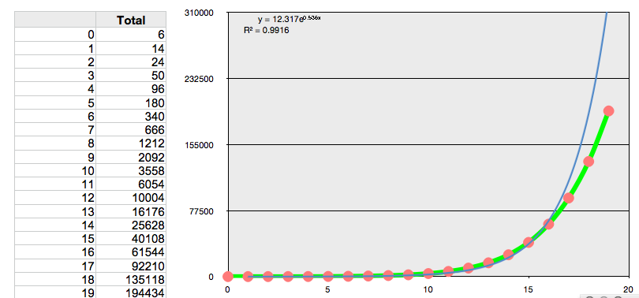
Self-Intersection-Combinatorial length in pants, aAbB
Open Problems:
Describe and explain patterns in columns.
More generally, describe the function F(L,i)=number of words in cell (L,i).
Sum F(L,i) over all L.

Slide 48
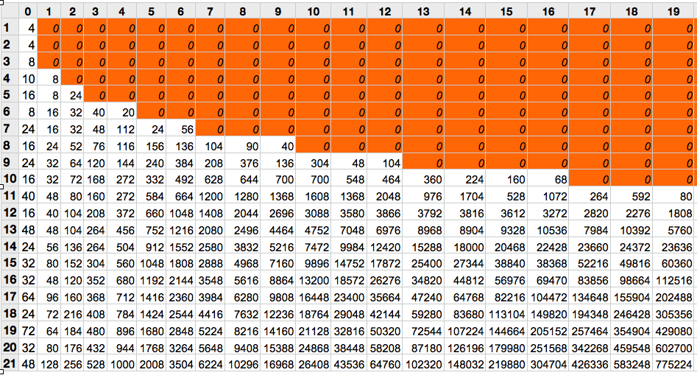
Self-intersection-Combinatorial length for the torus with one boundary abAB.
We consider a table similar to the one before, but counting only words that are not power of other words (for instance, we DO NOT count abab=(ab)²)

Slide 49
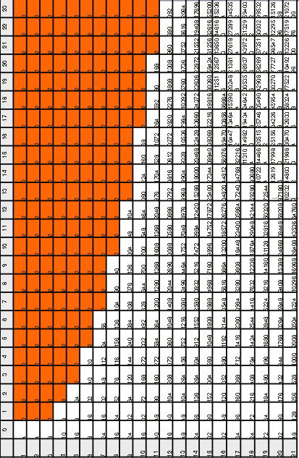
Theorem (Phillips, C.) Let w be a cyclic reduced word in a, b, A, B with L letters.
If w represents a conjugacy class in the fundamental group of the punctured torus abAB then the maximal self-intersection of w is at most
(L − 2)²/4 if L is even
(L - 1)(L - 3)/4 if L is odd
These bounds are sharp.

Slide 50
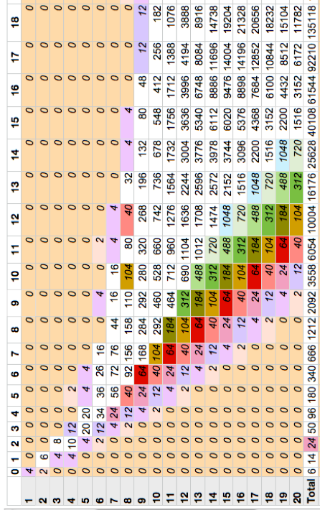
Theorem (Phillips, C.) Consider thrice puntured sphere aAbB. The maximal self-intersection of a cyclic reduced word of length L is at most
L²/4 + L/2 -1
If L is even, the bound is sharp.
Theorem: The self-intersection of such a word is at most (L-1)/2
Conjecture: If w is a cyclic reduced word of length L “labeling” a free homotopy class in the fundamental group of the thrice puntured sphere aAbB then the maximal self-intersection of w is at most
(L² − 1)/4;
If L is odd, the bound is sharp.

Slide 51

Theorem: When #A=4, max SI of L-word is approximately L²/4
By computer experiments, we conjecture:
  When #A=6, max SI of L-word is approximately L²/3
  When #A=8, max SI of L-word is approximately 3L²/8
Open problem: If #A/2=n, then the maximal self-intersection of a word of length L, is at most
(n-1)L²/(2n)
Compare to mean grows like

Slide 52
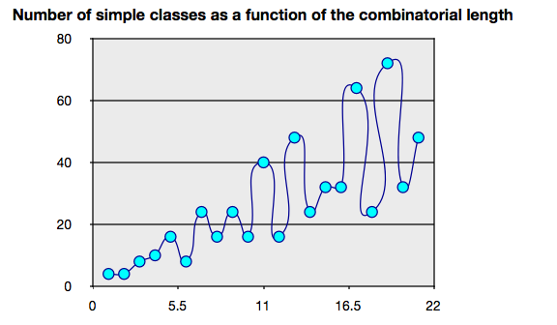
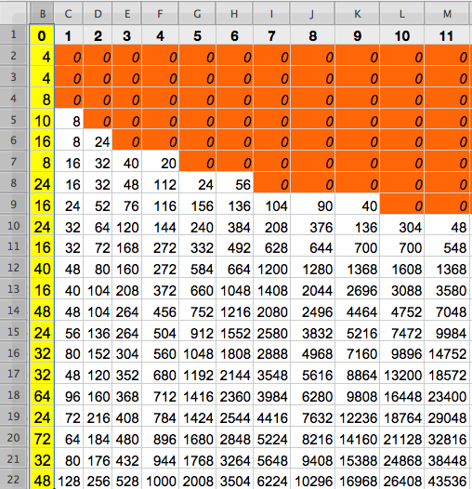
We study the first column (number of cyclic reduced words with 0 self-intersection as function of combinatorial length.

Slide 53
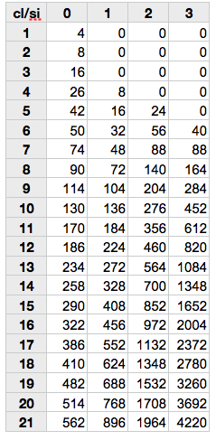
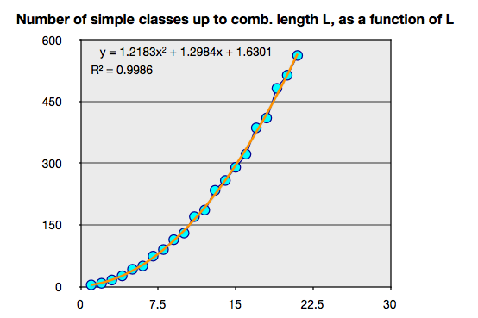
Row i, column j: number of words of self-int j of length at most i.
Maryam Mirzakhani proved that the growth of the column SI=0 is indeed quadratic.
Igor Rivin, using Mirzakhani’s ideas, proved that the growth of the column SI=1 is quadratic.
The computer experiment suggest that all columns yield quadratic functions.
Open problem: Find the coefficient of these quadratic functions.

Slide 54
Row i, column j: number of words of self-int j of length at most i.
Maryam Mirzakhani proved that the growth of the column SI=0 is indeed quadratic.
Igor Rivin, using Mirzakhani’s ideas, proved that the growth of the column SI=1 is quadratic.
The computer experiment suggest that all columns yield quadratic functions.
Open problem: Give a proof that conjecture and find the coefficient of these quadratic functions.
Maryam Mirzakhani proved that for a surface of g handles, and b holes, the column SI=0 grows like a polynomial of degree 6g-6+2b.
Igor Rivin proved that the column SI=1 grows like a polynomial of degree 6g-6+2b.
Open problem: Give a proof that conjecture and find the coefficient of these quadratic functions.
More generally, describe the function
F(L, SI) =cell (L, SI)

