Slide 1
Binomial probability distribution, n=100, p=1/6
Experimental
binomial probability distribution, 100 dice, repeated 250 times, p=1/6

Slide 3
Cosine program

Slide 4
Pythagorean triples

Slide 5
Fermat’s last theorem
“Cuius rei demonstrationem mirabilem sane detexi, hanc marginis exiguitas non ca- peret.” (“I have discovered a truly marvelous proof of this, which this margin is too narrow to contain.”)

Slide 6
Some of the mathematicians who worked in the proof of Fermat’s last theorem
Leonard Euler
Sophie Germain

Slide 7
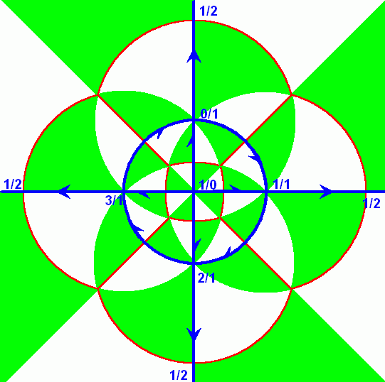
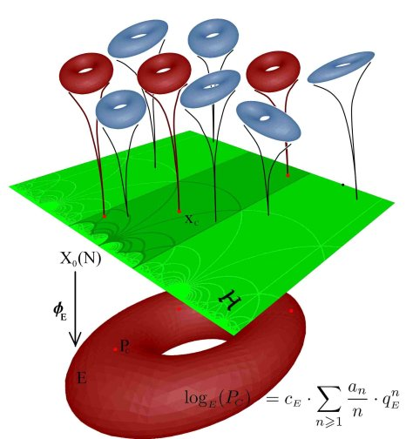
Andrew Wiles

Slide 8
Homer Simpson proved Fermat Last Theorem is wrong?

Slide 9
Homer Simpson proved Fermat Last Theorem is wrong?
What is the point of discussing Fermat’s theorem

Slide 10
Curve fitting

Slide 11
The height of a baby is measured during her first month of life.
When the baby is 1 day old, her height is 20.1 in.
When the baby is 15 days old, her height is 20.6 in.
When the baby is 20 days old, her height is 21.2 in.
When the baby is 29 days old, her height is 21.9 in.
Make a graph in Geogebra of the four points determined by the above data. (Input the points in a spreadsheet first). Use the settings to zoom the graph around the points.
Can you determine the height of the baby when she is 25 days old? Can you estimate it?
Can you find a line the line passing through the four points in 1?
Can you find a polynomial passing through the four points in 1?
Can you find a polynomial of degree 2? What about 3? And 4? What about degree larger than 4?
Can you find a line that passes “close” to the four points in 1.
What do I mean by close and closest?

Slide 12
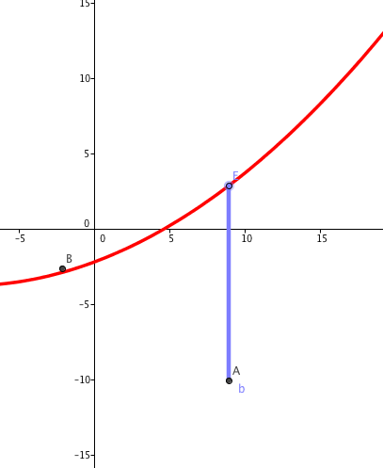
Geogebra Hints:
Curve[3sin(t)*cos(t),2tsin(t),t,0,8]
Define five points in Geogebra
Save the coordinates of these 5 points on a spreadsheet.
Define a linear function and plot it. (Use sliders for the slope and the y-intersect.)
Create a vertical segment from one of the points and the graph of the function.
Create a tool drawing a vertical segment from a given function to a given point.
In the spreadsheet, compute the square of the length of the segments.
Add up all these squared distances.
Drag the the parameters of the sliders, trying so the total result is the smallest possible.
Can you find (analytically) the values of the sliders that make the sum of the squares of the vertical distances smallest?

Slide 13
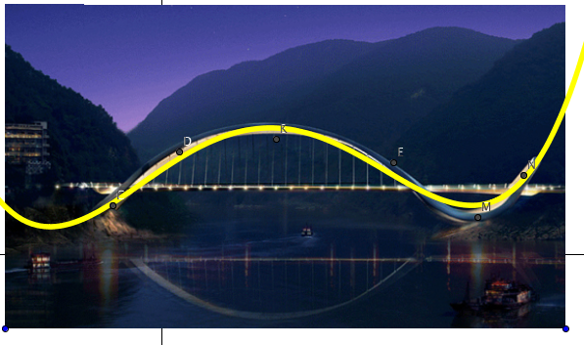
Geogebra Hints:
FitPoly[list of points, degree]
FitExp[]
Fit[ <List of Points>, <List of Functions> ]
FitExp, FitLine, FitLineX, FitLog, FitLogistic, FitPoly, FitPow and FitSin.
Polynomial[list of points]
Find a photo online that contains a curve.
Import the photo in Geogebra.
Choose a few points on the curve.
Choose a type of regression (in Geogebra you can use linear, polynomial, exponential among others) and use it to fit find the equation of a curve “close” to the curve in the picture.
What do we mean by “close”?
Experiment with different pictures and different degrees of polynomials.

Slide 14
Geogebra Hint:
Function[function, start value, end value]
If[x<-2,x,If[x>3,sin(x),x^3]]
Is it possible to find a linear function passing through the points any triple of points in the plane? Why or why not?
Is it possible to find a quadratic function passing through through the points any triple of points on the plane? Why or why not?
Given the points, [1,-1/2], [2,1], [2.4,1] and [3,1/3] find a piecewise linear function with domain the interval [1,3] passing through all of them.

