Slide 1
Descriptive Data Mining
Herbert F. Lewis, Ph.D.
College of Business
SBU Math Camp 2023

Slide 2
Descriptive Data Mining
Descriptive data mining involves analyzing historical data to identify patterns and relationships. Descriptive data mining produces summaries and visualizations of the data.
The increased use of data-mining techniques in business has occurred due to:
the explosion in the amount of data being produced and electronically tracked,
the ability to electronically warehouse these data, and
the decrease in the cost of computer power to analyze the data.

Slide 3
Unsupervised Learning
Observation (record): A set of observed values of variables associated with a single entity, often displayed as a row in a spreadsheet or database.
Unsupervised learning: A descriptive data-mining technique used to identify relationships between observations.
Thought of as high-dimensional descriptive analytics.
There is no outcome variable to predict; instead, qualitative assessments are used to assess and compare the results.

Slide 4
Examples of Descriptive Data Mining
Examples of descriptive data mining include clustering, association rule mining, and anomaly detection.
Clustering involves grouping similar objects together.
Association rule mining involves identifying relationships between different items in a dataset.
Anomaly detection involves identifying unusual patterns or outliers in the data.

Slide 5
Clustering
Goal of clustering is to segment observations into similar groups based on observed variables.
Can be employed during the data-preparation step to identify variables or observations that can be aggregated or removed from consideration.
Commonly used in marketing to divide customers into different homogenous groups; known as market segmentation.
Used to identify outliers.

Slide 6
Clustering Categorical Variables: Matching Coefficient
Matching coefficient: Measure of similarity between observations based on the number of matching values of categorical variables.
Matching distance: Measure of dissimilarity between observations based on the matching coefficient.

Slide 7
Clustering Categorical Variables: Matching Coefficient
Matching Coefficients for Titanic Passenger Data

Slide 8
Clustering Categorical Variables: Jaccard’s Coefficient
Jaccard’s coefficient: Measure of similarity between observations consisting solely of binary categorical variables that considers only matches of nonzero entries.
Jaccard distance: Measure of dissimilarity between observations based on Jaccard’s coefficient.

Slide 9
Clustering Categorical Variables: Jaccard’s Coefficient
Jaccard’s Coefficients for Titanic Passenger Data

Slide 10
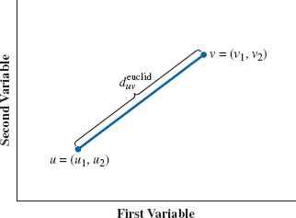
Euclidean Distance
Euclidean distance: Geometric measure of dissimilarity between observations based on the Pythagorean theorem.
For two observations,
the Euclidean distance is:
$$u=\left(u_{1}\text{, }u_{2}, …\text{, }u_{q}\right)$$
$$v=\left(v_{1}\text{, }v_{2}\text{, }…\text{, }v_{q}\right)$$
$$d_{uv}=\sqrt{{\left(u_{1}−v_{1}\right)}^{2}+{\left(u_{2}−v_{2}\right)}^{2}+⋅⋅⋅+{\left(u_{q}−v_{q}\right)}^{2}}$$

Slide 11
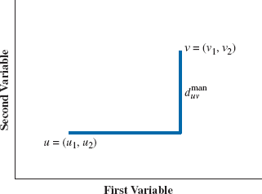
Manhattan Distance
Manhattan distance: Measure of dissimilarity between two observations based on the sum of the absolute differences in each variable dimension.
For two observations,
the Manhattan distance is:
$$u=\left(u_{1}\text{, }u_{2}, …\text{, }u_{q}\right)$$
$$v=\left(v_{1}\text{, }v_{2}\text{, }…\text{, }v_{q}\right)$$
$$d_{uv}=\left|u_{1}−v_{1}\right|+\left|u_{2}−v_{2}\right|+⋅⋅⋅+\left|u_{q}−v_{q}\right|$$

Slide 12
Standardized Distance
Both Euclidean and Manhattan distance are highly influenced by the scale on which variables are measured.
It is common to replace each variable u_{j} of observation u with its z-score z_{j}.
The conversion to z-scores also makes it easier to identify outlier measurements, which can distort the distance between observations.

Slide 13
Clustering Numerical Data: k-Means
k-means clustering: Process of organizing observations into one of k groups based on a measure of similarity (typically Euclidean distance).
Given a value of k, the k-means algorithm randomly assigns each observation to one of the k clusters.
After all observations have been assigned to a cluster, the resulting cluster centroids are calculated.
Using the updated cluster centroids, all observations are reassigned to the cluster with the closest centroid.

Slide 14
Clustering Numerical Data: k-Means (2 Clusters)
Initial Clusters for Facility Location Data

Slide 15
Clustering Numerical Data: k-Means (2 Clusters)
Iteration 1 Clusters for Facility Location Data

Slide 16
Clustering Numerical Data: k-Means (2 Clusters)
Iteration 2 Clusters for Facility Location Data

Slide 17
Clustering Numerical Data: k-Means (2 Clusters)
Iteration 3 Clusters for Facility Location Data

Slide 18
Clustering Numerical Data: k-Means (2 Clusters)

Slide 19
Average Distances Within Clusters

Slide 20
Distances Between Cluster Centroids

Slide 21
k-Means Optimization (2 Clusters)
$A_{j}$=$\left\{\begin{matrix}1 if observation j is in cluster A \\ 0 otherwise \end{matrix}\right.$ $∀j=1,2,…,n$
$B_{j}$=$\left\{\begin{matrix}1 if observation j is in cluster B \\ 0 otherwise \end{matrix}\right.$ $∀j=1,2,…,n$
$\left(X_{j},Y_{j}\right)$ are the coordinates of observation j $∀j=1,2,…,n$
$\left(X_{A},Y_{A}\right)$ is the centroid of cluster A
$\left(X_{B},Y_{B}\right)$ is the centroid of cluster B
$d_{Aj}$= ${\left(X_{A}−X_{j}\right)}^{2}$+ ${\left(Y_{A}−Y_{j}\right)}^{2}$ $∀j=1,2,…,n$
$d_{Bj}$= ${\left(X_{B}−X_{j}\right)}^{2}$+ ${\left(Y_{B}−Y_{j}\right)}^{2}$ $∀j=1,2,…,n$
$\text{Minimize}$ $\sum_{j=1}^{n}{d_{Aj}A_{j}+d_{Bj}B_{j}}$
Subject to
${ A}_{j}+$ $B_{j}$=1 $∀j=1,2,…,n$
${ A}_{j},B_{j}=0,1$ $∀j=1,2,…,n$
${ X}_{A},Y_{A}$, $X_{B},Y_{B}≥0$

Slide 22
Clustering Numerical Data: k-Means (3 Clusters)
Initial Clusters for Facility Location Data

Slide 23
Clustering Numerical Data: k-Means (3 Clusters)
Iteration 1 Clusters for Facility Location Data

Slide 24
Clustering Numerical Data: k-Means (3 Clusters)
Iteration 2 Clusters for Facility Location Data

Slide 25
Clustering Numerical Data: k-Means (3 Clusters)

Slide 26
Average Distances Within Clusters

Slide 27
Distances Between Cluster Centroids

Slide 28
Hierarchical Clustering
Hierarchical clustering: Process of agglomerating observations into a series of nested groups based on a measure of similarity.
Starts with each observation in its own cluster and then iteratively combines the two clusters that are the most similar into a single cluster.
There are several ways obtain a cluster similarity measure:
Single linkage,
Complete linkage,
Group average linkage,
Median linkage, or
Centroid linkage.

Slide 29
Hierarchical Clustering: Linkage
Single linkage: Measure of calculating dissimilarity between clusters by considering only the two most similar observations between the two clusters.
Complete linkage: Measure of calculating dissimilarity between clusters by considering only the two most dissimilar observations between the two clusters.
Group average linkage: Measure of calculating dissimilarity between clusters by considering the distance between each pair of observations between two clusters.
Median linkage: Method that computes the similarity between two clusters as the median of the similarities between each pair of observations in the two clusters.
Centroid linkage: Method of calculating dissimilarity between clusters by considering the two centroids of the respective clusters.

Slide 30
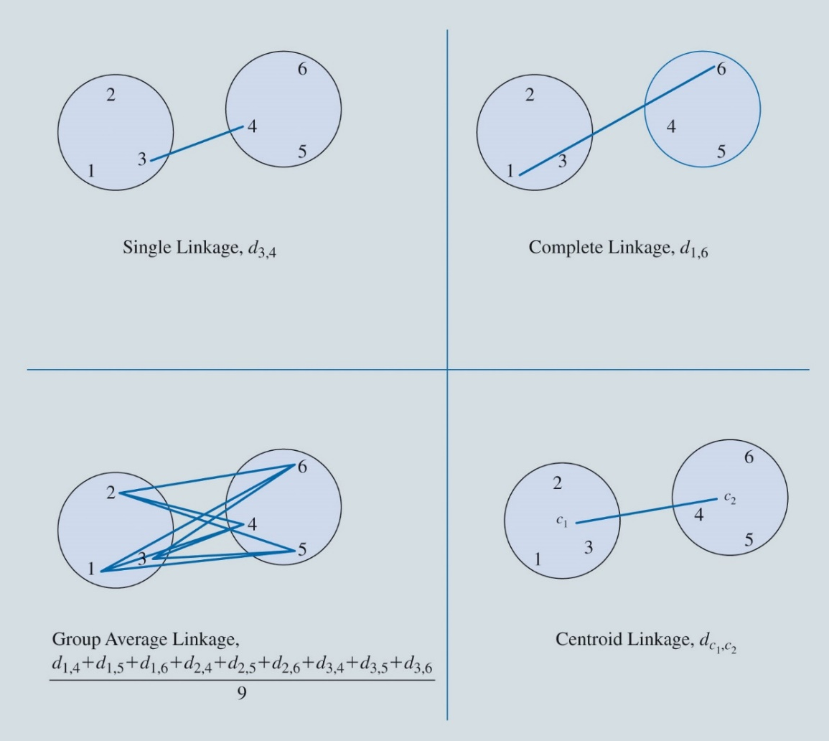
Hierarchical Clustering : Linkage

Slide 31
Hierarchical Clustering: Methods
Ward’s method: Procedure that partitions observations in a manner to obtain clusters with the least amount of information loss due to the aggregation.
McQuitty’s method: Measure that computes the dissimilarity introduced by merging clusters A and B by, for each other cluster C, averaging the distance between A and C and the distance between B and C and summing these average distances.
Dendrogram: A tree diagram used to illustrate the sequence of nested clusters produced by hierarchical clustering.

Slide 32
Hierarchical Clustering versus k-Means Clustering
Hierarchical Clustering | k-Means Clustering
Suitable when we have a small data set (e.g., fewer than 500 observations) and want to easily examine solutions with increasing numbers of clusters. | Suitable when you know how many clusters you want and you have a larger data set (e.g., more than 500 observations).
Convenient method if you want to observe how clusters are nested. | Partitions the observations, which is appropriate if trying to summarize the data with k “average” observations that describe the data with the minimum amount of error.

Slide 33
Association Rules
Association rule: An if–then statement describing the relationship between item sets.
Antecedent: The item set corresponding to the if portion of an if–then association rule.
Consequent: The item set corresponding to the then portion of an if–then association rule.
Support: The percentage of transactions in which a collection of items occurs together in a transaction data set.

Slide 34
Association Rules: Confidence and Lift Ratio
Confidence: The conditional probability that the consequent of an association rule occurs given the antecedent occurs.
Lift ratio: The ratio of the performance of a data mining model measured against the performance of a random choice. In the context of association rules, the lift ratio is the ratio of the probability of the consequent occurring in a transaction that satisfies the antecedent versus the probability that the consequent occurs in a randomly selected transaction.

Slide 35
Association Rules: 1 Antecedent 1 Consequent
Supports, Confidences, and Lift Ratios for Titanic Passenger Data

Slide 36
Association Rules: 2 Antecedents 1 Consequent
Antecedents Supports for Titanic Passenger Data

Slide 37
Association Rules: 2 Antecedents 1 Consequent
Antecedents and Consequent Supports for Titanic Passenger Data

Slide 38
Association Rules: 2 Antecedents 1 Consequent
Confidences for Titanic Passenger Data

Slide 39
Association Rules: 2 Antecedents 1 Consequent
Lift Ratios for Titanic Passenger Data

Slide 40
Text Mining
Text mining: The process of extracting useful information from text data.
Unstructured data: Data, such as text, audio, or video, that cannot be stored in a traditional structured database.
Data mining with text data is more challenging than data mining with traditional numerical data, because it requires more preprocessing to convert the text to a format amenable for analysis.

Slide 41
Text Mining Terminology
Document: A piece of text, which can range from a single sentence to an entire book depending on the scope of the corresponding corpus.
Corpus: A collection of documents to be analyzed.
Term: The most basic unit of text comprising a document, typically corresponding to a word or word stem.

Slide 42
Bag of Words
Bag of words: An approach for processing text into a structured row-column data format in which documents correspond to row observations and words (or more specifically, terms) correspond to column variables.

Slide 43
Preprocessing Text Data for Analysis
Tokenization: The process of dividing text into separate terms, referred to as tokens.
Term normalization: A set of natural language processing techniques to map text into a standardized form.
Symbols and punctuations must be removed from the document, and all letters should be converted to lowercase.
Different forms of the same word and synonyms probably should not be considered as distinct terms.
Stemming: The process of converting a word to its stem or root word.
Stopwords: Common words in a language that are removed in the pre-processing of text.

Slide 44
Binary Document-Term Matrix
Binary document-term matrix (Presence/absence document-term matrix): A matrix with the rows representing documents (units of text) and the columns representing terms (words or word roots), and the entries in the columns indicating either the presence or absence of a particular term in a particular document (1 = present and 0 = not present).

Slide 45
Binary Document-Term Matrix Example
Data for Airline Passenger Concerns

Slide 46
Binary Document-Term Matrix Example
Binary Document-Term Matrix for Airline Passenger Concerns
 | Term
Document | Delayed | Flight | Horrible | Recline | Rude | Seat | Service
1 | 0 | 0 | 1 | 0 | 0 | 0 | 1
2 | 0 | 0 | 0 | 0 | 0 | 1 | 0
3 | 1 | 1 | 0 | 0 | 0 | 0 | 0
4 | 0 | 0 | 0 | 1 | 0 | 1 | 0
5 | 0 | 0 | 1 | 0 | 1 | 0 | 1
6 | 0 | 1 | 0 | 0 | 1 | 0 | 1
7 | 1 | 1 | 0 | 0 | 0 | 0 | 0
8 | 0 | 0 | 0 | 1 | 0 | 1 | 0
9 | 0 | 1 | 0 | 0 | 0 | 0 | 0
10 | 0 | 0 | 0 | 0 | 0 | 1 | 0

Slide 47
Binary Document-Term Matrix Example
Hierarchical Clustering for Airline Passenger Concerns
Cluster 1: | {1, 5, 6} | = | documents discussing service issues
Cluster 2: | {2, 4, 8, 10} | = | documents discussing seat issues
Cluster 3: | {3, 7, 9} | = | documents discussing schedule issues

Slide 48
Frequency Document-Term Matrix
Frequency document-term matrix: A matrix whose rows represent documents (units of text) and columns represent terms (words or word roots), and the entries in the matrix are the number of times each term occurs in each document.

Slide 49
Frequency Document-Term Matrix Example
Data for Movie Reviews
A new action film has been released, and we have a sample of 10 reviews from movie critics.
Using preprocessing techniques, we have reduced the number of tokens to only two: “great” and “terrible.”
Sentiment analysis: The process of clustering/categorizing comments or reviews as positive, negative, or neutral.

Slide 50
Frequency Document-Term Matrix Example
Frequency Document-Term Matrix for Movie Reviews
 | Term
Document | Great | Terrible
1 | 5 | 0
2 | 5 | 1
3 | 5 | 1
4 | 3 | 3
5 | 5 | 1
6 | 0 | 5
7 | 4 | 1
8 | 5 | 3
9 | 1 | 3
10 | 1 | 2

Slide 51
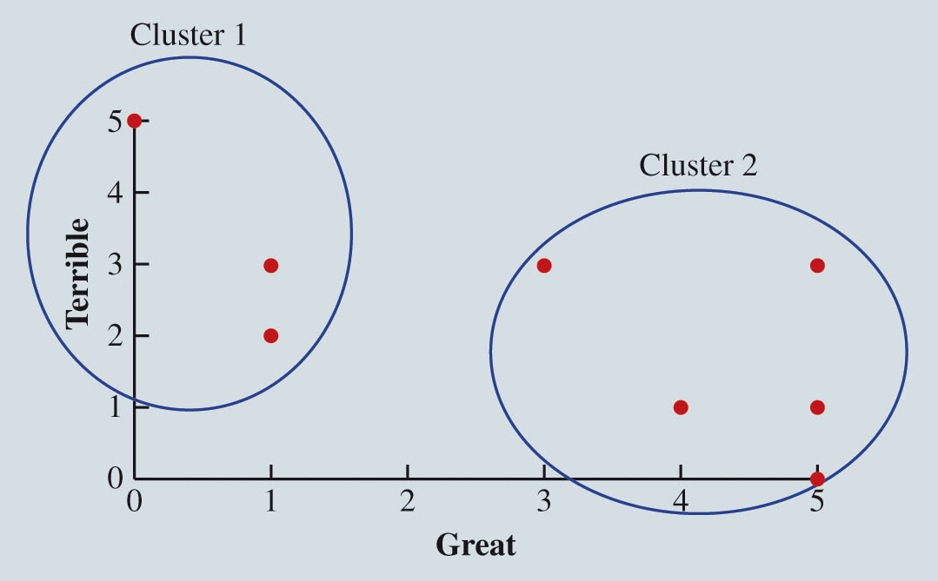
Frequency Document-Term Matrix Example
k-Means Clustering for Movie Reviews

Slide 52
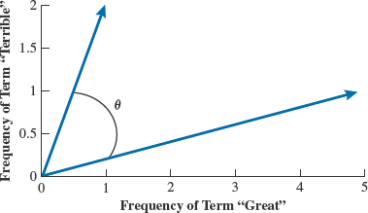
Frequency Document-Term Matrix Example
Distance Measurement for Movie Reviews
Cosine distance: A measure of dissimilarity between two observations often used on frequency data derived from text because it is unaffected by the magnitude of the frequency and instead measures differences in frequency patterns.
Review 10
Review 2

Slide 53
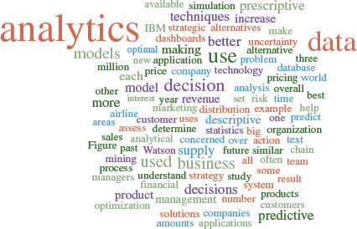
Word Cloud
Word cloud: A visualization of text data based on word frequencies in a document or set of documents.

