Slide 1
Math Camp
July 14, 2025

Slide 2
Deicer and Solvent Problem Graphical and Computer Solution
Herbert F. Lewis, Ph.D.

Slide 3
LP Formulation
Let D = the number of drums of Deicer produced
Let S = the number of drums of Solvent produced
Max 100D + 60S Objective Function
subject to
25D + 0S ≤ 1000 Liquid C Constraint
15D + 5S ≤ 1000 Liquid N Constraint
10D + 7S ≤ 1000 Liquid D Constraint
0D + 8S ≤ 1000 Liquid Q Constraint
D, S ≥ 0 Nonnegativity Constraints
Herbert F. Lewis, Ph.D.

Slide 4
Alternative LP Formulation
Let D = the number of gallons of Deicer produced
Let S = the number of gallons of Solvent produced
Max 2D + 3S Objective Function
subject to
0.5D + 0S ≤ 1000 Liquid C Constraint
0.3D + 0.25S ≤ 1000 Liquid N Constraint
0.2D + 0.35S ≤ 1000 Liquid D Constraint
0D + 0.4S ≤ 1000 Liquid Q Constraint
D, S ≥ 0 Nonnegativity Constraints
Herbert F. Lewis, Ph.D.

Slide 5
Solving Linear Programs
Graphical Method (two decision variables)
Simplex Method (any number of decision variables)
Linear Algebraic approach
Developed by George Dantzig in 1947
Computer Solution (using the Simplex Method)
Excel with Solver Add-In
R, Python
Commercial Software Packages
Herbert F. Lewis, Ph.D.

Slide 6
Graphing the Constraints
Herbert F. Lewis, Ph.D.

Slide 7
Graphing the Objective Function
Herbert F. Lewis, Ph.D.

Slide 8
Solving for the Optimal Solution
The optimal solution occurs at the intersection of the constraints for Liquid N and Liquid D.
Thus, we simultaneously solve: 15D + 5S =1000 and 10D + 7S =1000
First: 15D + 5S =1000 → 5S = 1000 – 15D → S = 200 – 3D
Next: 10D + 7S =1000 → 10D + 7(200 – 3D) = 1000 → -11D = -400 → D = 36.36
Finally: S = 200 – 3D → S = 90.91
The optimal solution is to produce 36.36 drums of Deicer and 90.91 drums of Solvent.
The total profit is $100(36.36) + $60(90.91) = $9090.91.
Herbert F. Lewis, Ph.D.

Slide 9
Solution Summary
Optimal Solution: (36.36, 90.91)
Maximum Profit: $9090.91
Constraint | LHS | RHS | Slack | Type
Liquid C | 909.09 | 1000 | 90.91 | Nonbinding
Liquid N | 1000 | 1000 | 0 | Binding
Liquid D | 1000 | 1000 | 0 | Binding
Liquid Q | 727.27 | 1000 | 272.73 | Nonbinding
Herbert F. Lewis, Ph.D.

Slide 10
Excel Setup (values)
Herbert F. Lewis, Ph.D.

Slide 11
Excel Setup (formulae)
Herbert F. Lewis, Ph.D.

Slide 12
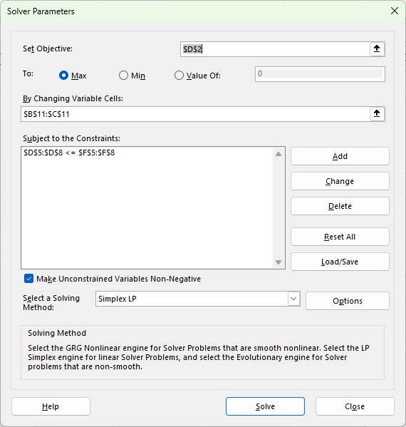
Solver Setup
Herbert F. Lewis, Ph.D.

Slide 13
Excel Solution
Herbert F. Lewis, Ph.D.

Slide 14
Solver Answer Report
Herbert F. Lewis, Ph.D.

Slide 15
Solver Sensitivity Report
Herbert F. Lewis, Ph.D.

